Slide 1

Microsoft Code Fun Do
Team
Shubham Jha
Nischay Mamidi
Saurabh Khandelwal

Slide 2
Parkinson
What is Parkinson
Parkinson’s disease is a complex neurodegenerative disease that affects a large portion of the worldwide population. With current prevalence rates, ranging from 10 to 800 people per 100,000, PD is one of the most common neurodegenerative disorders.
What is the Problem?
There is currently no objective method for diagnosing PD. It can take months to get a reliable PD diagnosis, and symptoms need to be carefully monitored. Even then the probability of an inaccurate diagnosis is approximately 25%.
What do we do?
We used the Parkinson’s disease handwriting (PaHaW) database,.The results confirmed that handwriting is relevant in diagnosing and monitoring PD.We used the ...

Slide 3
Dataset Description
The PD and control handwriting database consists of 62 PWP (People with parkinson) and 15 healthy individuals who appealed at the Department of Neurology in Cerrahpasa Faculty of Medicine, Istanbul University. From all subjects, three types of handwriting recordings (Static Spiral Test (SST), Dynamic Spiral Test (DST) and Stability Test on Certain Point (STCP)) are taken. Also the drawings of spirals belongs to the PWP are included in the dataset as image

Slide 4
Features Extraction
Feature Extraction was a tricky part but after intensive analysis we decided on the following features.
1. No of strokes
2. Stroke speed
3. Velocity
4. Acceleration
5. Jerk
6. Horizontal velocity/acceleration/jerk
7. Vertical velocity/acceleration/jerk
8. Number of changes in velocity direction
9. Number of changes in acceleration direction
10. in-air time
11. on-surface time

Slide 5
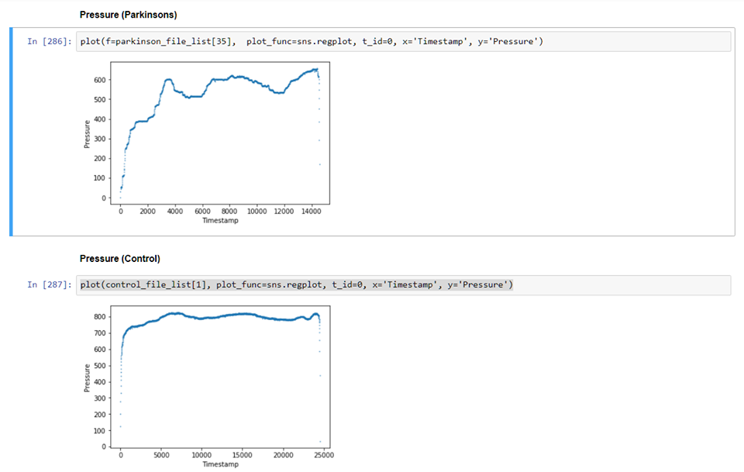
Sample Attribute Difference between affected and normal

Slide 6
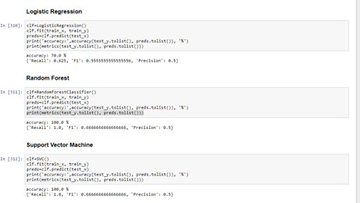
Classifier Used and result

Slide 7
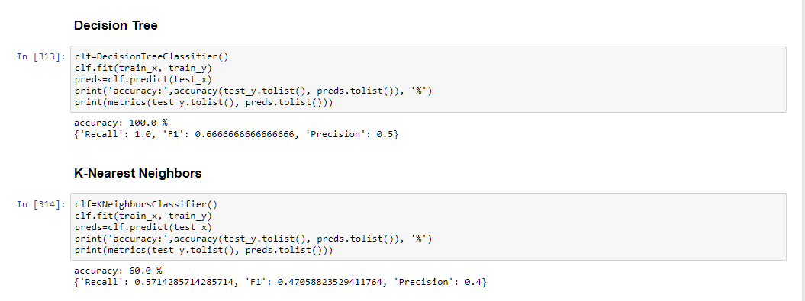
Classifier Used and Result

Slide 8
Conclusion
SVM Classifier gave the best result with
ACCURACY: 100%
F1 SCORE : 0.66
PRECISION : 0.5
RECALL : 1

Slide 9
Future Vision
As indicated in Results, not all handwriting tasks provide the same level of discrimination power. After evaluating our results, it is evident that some features are more useful for diagnosis than others.We can use actual handwriting to improve on our results
Decision support tools are gaining significant research interest due to their potential to improve health-care provision. Among many possible approaches, those that provide noninvasive monitoring and diagnosis of diseases are of increased interest to clinicians and biomedical engineers.
We aim to provide this diagnosis to people in remote areas where healthcare is not just lacking but extremely inadequate.

Slide 10
Tools We Used
Jupyter Notebook
Python (Version 3.6)
PaWaH Dataset
Seaborn
Scikit-Learn
Pandas
Numpy

Slide 11
References and Bibliography
Analysis of in-air movement in handwriting: A novel marker for Parkinson’s disease
Evaluation of handwriting kinematics and pressure for differential diagnosis of Parkinson’s disease
http://parkinson.org/understanding-parkinsons
https://www.ninds.nih.gov/Disorders/All-Disorders/Parkinsons-Disease-Information-Page

Slide 12
Rest of all the results, source code and the visualization can be found at our GitHub repo.
Link- https://github.com/shubhamjha97/parkinson-detection

